Slide 1


RAGHVENDRA SINGH
12/30/2023

Slide 2

Outline
Executive Summary
Introduction
Methodology
Results
Conclusion
Appendix

Slide 3
Executive Summary
Summary of methodologies
Data Collection through API
Data Collection with Web Scraping
Data Wrangling
Exploratory Data Analysis Using SQL
Exploratory Data Analysis Using PANDAS and MATPLOTLIB
Interactive Visual Analytics and Dashboard with Plotly dash
Machine Learning - Predictive Analysis
Summary of all results
Hands on , files uploaded to Git Hub
Screenshots – Charts and other visuals

Slide 4
Introduction
Project background and context
In this project, we will predict if the Falcon 9 first stage will land successfully. SpaceX advertises Falcon 9 rocket launches on its website, with a cost of 62 million dollars; other providers cost upward of 165 million dollars each, much of the savings is because SpaceX can reuse the first stage. Therefore if we can determine if the first stage will land, we can determine the cost of a launch. This information can be used if an alternate company wants to bid against Space X for a rocket launch.
Problems you want to find answers
Determine if Space X will reuse the first stage.
Determine if the first stage will land successfully,
What factors determine if the rocket will land successfully?
The interaction amongst various features that determine the success rate of a successful landing.
.

Slide 5

Section 1

Slide 6
Methodology
Executive Summary
Data collection methodology:
Data was collected using Space X API and web scraping from Wikipedia.
Perform data wrangling
One-hot encoding was applied to categorical features.
Perform exploratory data analysis (EDA) using visualization and SQL
Perform interactive visual analytics using Folium and Plotly Dash
Perform predictive analysis using classification models
Split the data into training testing data
Train different classification models
Optimize the Hyperparameter grid search

Slide 7
Data Collection
Describe how data sets were collected.
Wrangling data Using an API/ Web Scrapping
Sampling Data
Dealing with Nulls
You need to present your data collection process use key phrases and flowcharts
Request and parse data using the GET request
Data filtering
Dealing with missing values

Slide 8

Data Collection – SpaceX API
Present your data collection with SpaceX REST calls using key phrases and flowcharts
https://github.com/RaghvendraTomar/DataScienceEcosystem/blob/main/jupyter-labs-spacex-data-collection-api.ipynb
Place your flowchart of SpaceX API calls here

Slide 9

Data Collection - Scraping
https://github.com/RaghvendraTomar/DataScienceEcosystem/blob/main/jupyter-labs-webscraping.ipynb
Place your flowchart of web scraping here

Slide 10
Data Wrangling
We performed exploratory data analysis and determined the training labels.
We calculated the number of launches at each site, and the number and occurrence of each orbits
We created landing outcome label from outcome column and exported the results to csv.
https://github.com/RaghvendraTomar/DataScienceEcosystem/blob/main/jupyter-labs-spacex-data-collection-api.ipynb

Slide 11


EDA with Data Visualization
Explored the data by visualizing the relationship between flight number and launch Site, payload and launch site, success rate of each orbit type, flight number and orbit type, the launch success yearly Add the GitHub URL of your completed EDA with data visualization notebook, as an external reference and peer-review purpose
https://github.com/RaghvendraTomar/DataScienceEcosystem/blob/main/jupyter-labs-eda-dataviz.ipynb.jupyterlite.ipynb

Slide 12
EDA with SQL
Applied EDA with SQL to get insight from the data. We wrote queries to find out for instance:
The names of unique launch sites in the space mission.
The total payload mass carried by boosters launched by NASA (CRS)
The average payload mass carried by booster version F9 v1.1
The total number of successful and failure mission outcomes
The failed landing outcomes in drone ship, their booster version and launch site names.
https://github.com/RaghvendraTomar/DataScienceEcosystem/blob/main/jupyter-labs-eda-sql-coursera_sqllite.ipynb

Slide 13
Build an Interactive Map with Folium
Marked all launch sites, and added map objects such as markers, circles, lines to mark the success or failure of launches for each site on the folium map.
Assigned the feature launch outcomes (failure or success) to class 0 and 1.i.e., 0 for failure, and 1 for success.
Using the color-labeled marker clusters, identified which launch sites have relatively high success rate.
Calculated the distances between a launch site to its proximities. We answered some question for instance:
Are launch sites near railways, highways and coastlines.
Do launch sites keep certain distance away from cities.

Slide 14
Build a Dashboard with Plotly Dash
Built an interactive dashboard with Plotly dash
Plotted pie charts showing the total launches by a certain sites
Plotted scatter graph showing the relationship with Outcome and Payload Mass (Kg) for the different booster version.
https://github.com/RaghvendraTomar/DataScienceEcosystem/blob/main/spacex_dash_app.py

Slide 15
Predictive Analysis (Classification)
Loaded the data using numpy and pandas, transformed the data, split our data into training and testing.
Built different machine learning models and tune different hyperparameters using GridSearchCV.
Used accuracy as the metric for our model, improved the model using feature engineering and algorithm tuning.
Found the best performing classification model.
https://github.com/RaghvendraTomar/DataScienceEcosystem/blob/main/SpaceX_Machine_Learning_Prediction_Part_5.jupyterlite%20(1).ipynb

Slide 16
Results
Exploratory data analysis results
Interactive analytics demo in screenshots
Predictive analysis results

Slide 17

Section 2

Slide 18

Flight Number vs. Launch Site

Slide 19
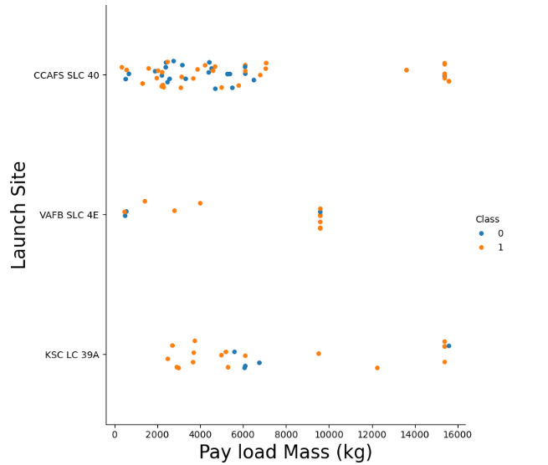
Payload vs. Launch Site
For the VAFB-SLC launchsite there are no rockets launched for heavy payload mass(greater than 10000).

Slide 20
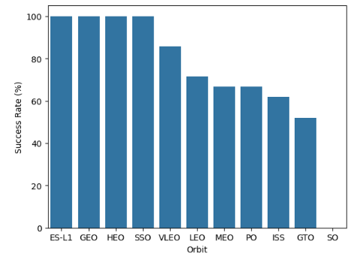
Success Rate vs. Orbit Type
From the plot, we can see that ES-L1, GEO, HEO, SSO, VLEO had the most success rate.

Slide 21
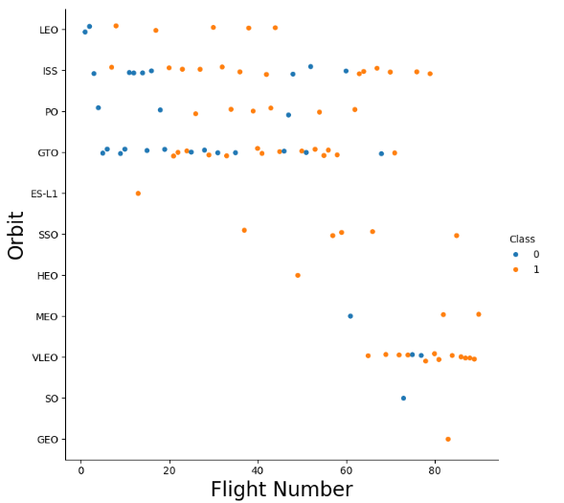
Flight Number vs. Orbit Type
With heavy payloads the successful landing or positive landing rate are more for Polar,LEO and ISS.
For GTO we cannot distinguish this well as both positive landing rate and negative landing(unsuccessful mission) are both there here.

Slide 22
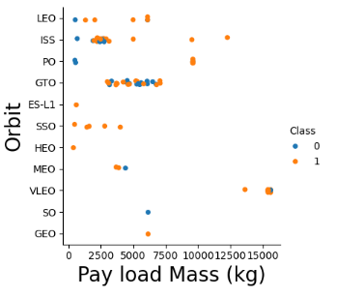
Payload vs. Orbit Type
We can observe that with heavy payloads, the successful landing are more for PO, LEO and ISS orbits.

Slide 23
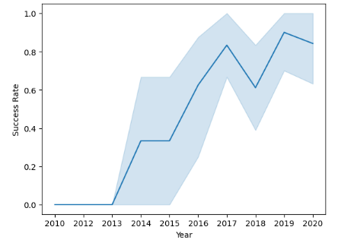
Launch Success Yearly Trend
From the plot, we can observe that success rate since 2013 kept on increasing till 2020

Slide 24
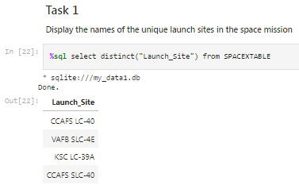
All Launch Site Names
Find the names of the unique launch sites

Slide 25
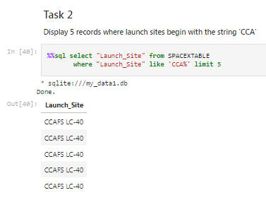
Launch Site Names Begin with 'CCA'
Used the query below to display 5 records where launch sites begin with `CCA`

Slide 26
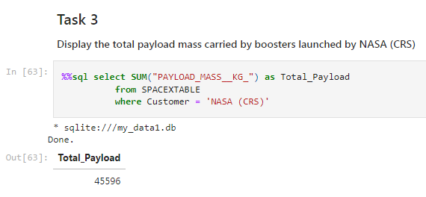
Total Payload Mass
Calculated the total payload carried by boosters launched by NASA (CRS) as 45596 using the query below

Slide 27
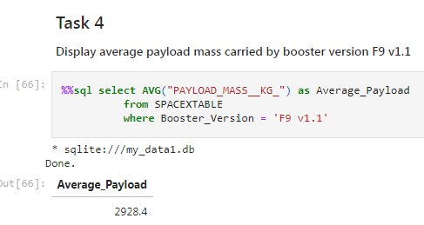
Average Payload Mass by F9 v1.1
Calculated the average payload mass carried by booster version F9 v1.1 as 2928.4

Slide 28
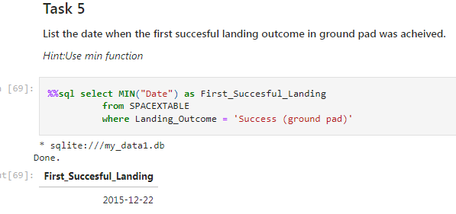
First Successful Ground Landing Date
Date of the first successful landing outcome on ground pad was 22nd December 2015

Slide 29
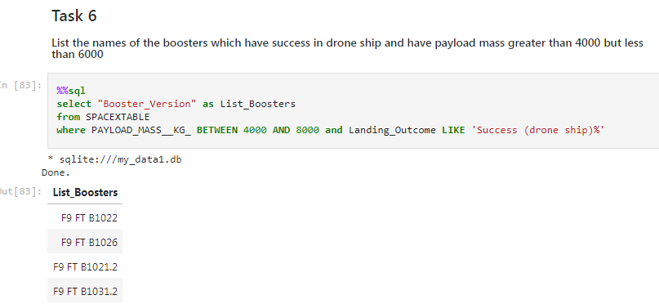
Successful Drone Ship Landing with Payload between 4000 and 6000
Below is the list of the boosters which have success in drone ship and have payload between 4000 and 6000

Slide 30
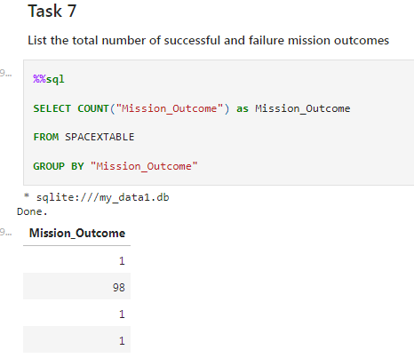
Total Number of Successful and Failure Mission Outcomes
Total number of successful and failure mission outcomes

Slide 31
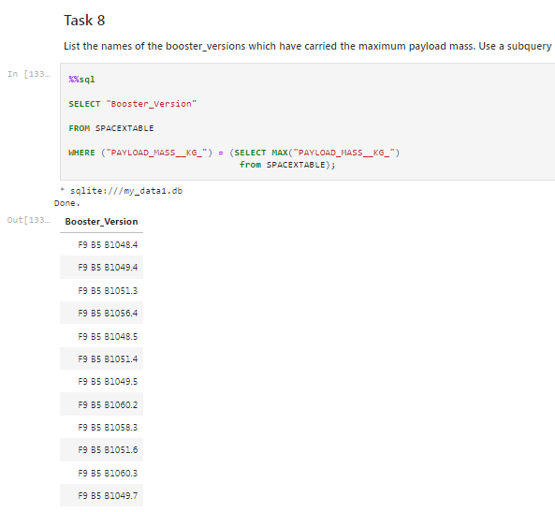
Boosters Carried Maximum Payload

Slide 32
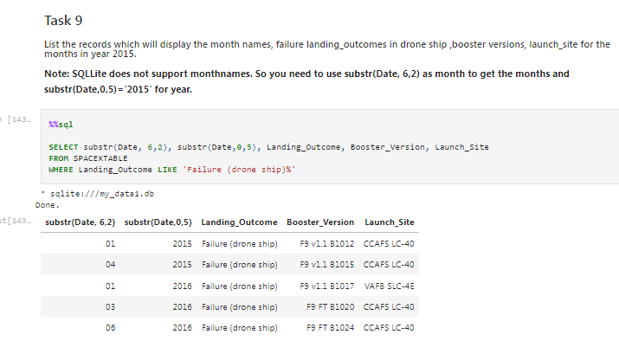
2015 Launch Records
Used a combinations of the WHERE clause, LIKE, conditions to filter for failed landing outcomes in drone ship, their booster versions, and launch site names for year 2015

Slide 33
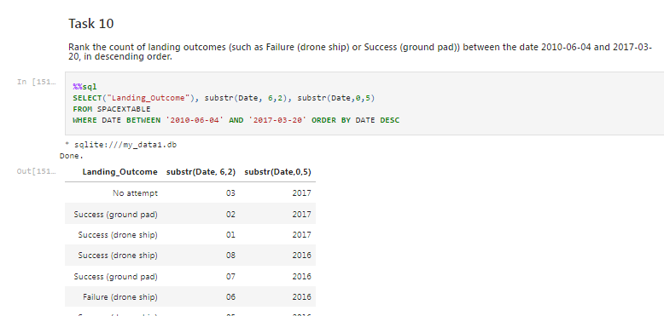
Rank Landing Outcomes Between 2010-06-04 and 2017-03-20

Slide 34

Section 3

Slide 35
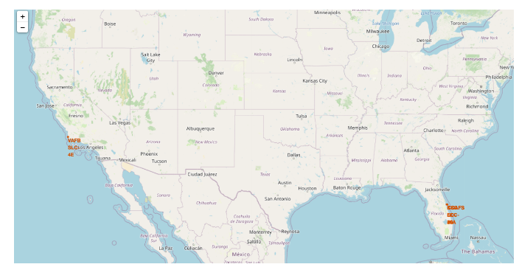
All launch sites global map markers:

Slide 36

Markers showing launch sites with color labels
Replace <Folium map screenshot 2> title with an appropriate title
Explore the folium map and make a proper screenshot to show the color-labeled launch outcomes on the map
Explain the important elements and findings on the screenshot

Slide 37
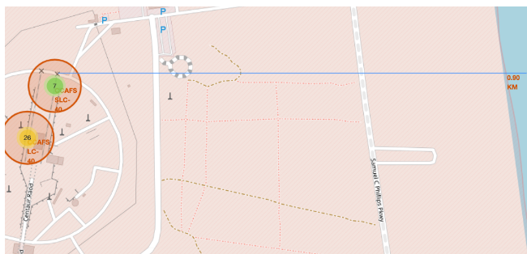
Map with distance line from Launch Site

Slide 38

Section 4

Slide 39
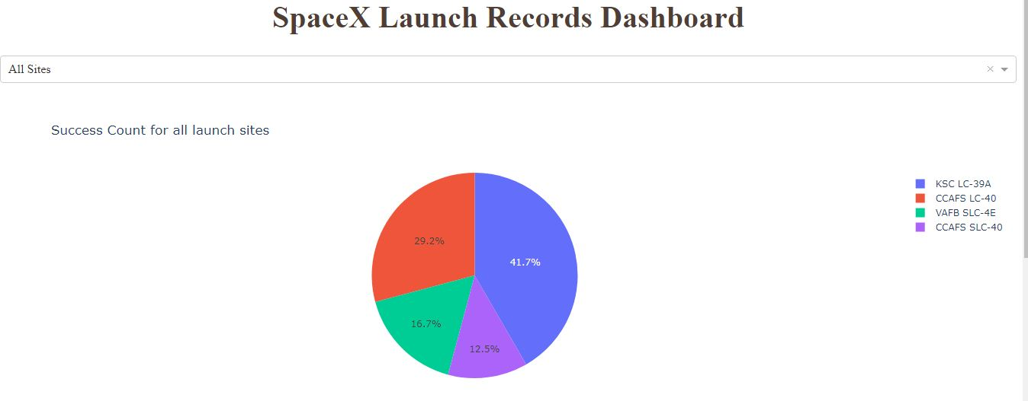
Pie chart showing the success percentage achieved by each launch site

Slide 40
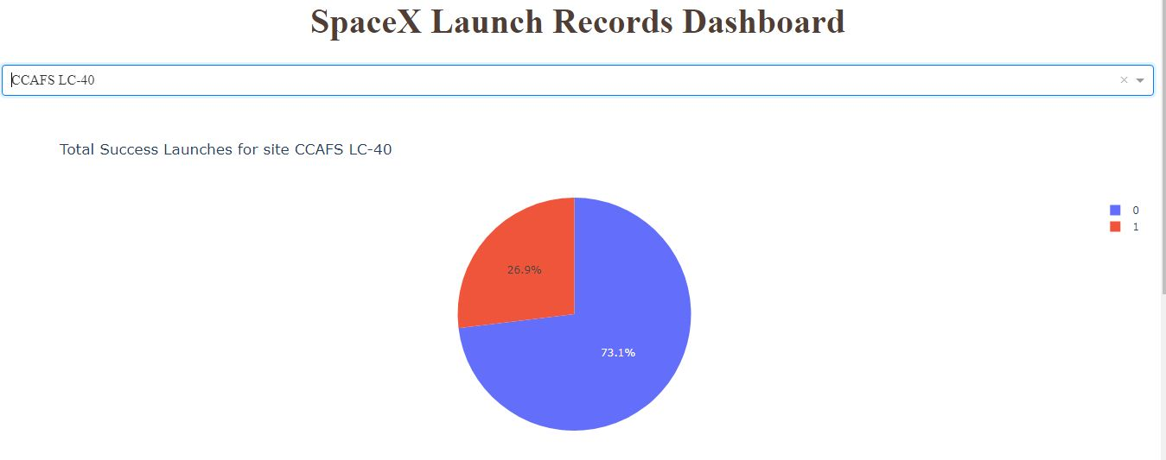
Pie chart showing the Launch site with the highest launch success ratio

Slide 41
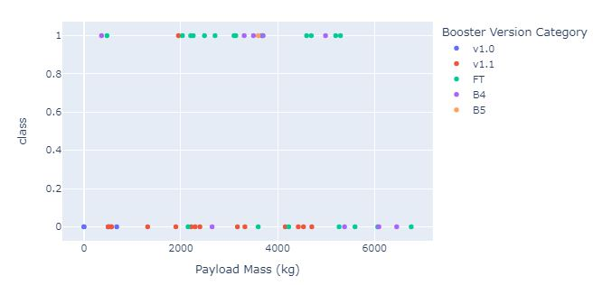
Scatter plot of Payload vs Launch Outcome for all sites

Slide 42

Section 5

Slide 43
Classification Accuracy
Visualize the built model accuracy for all built classification models, in a bar chart
Find which model has the highest classification accuracy

Slide 44
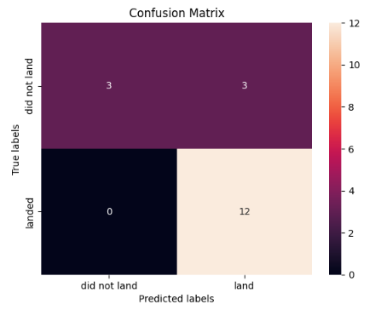
Confusion Matrix
The confusion matrix for the decision tree classifier shows that the classifier can distinguish between the different classes. The major problem is the false positives .i.e., unsuccessful landing marked as successful landing by the classifier.

Slide 45
Conclusions
The larger the flight amount at a launch site, the greater the success rate at a launch site.
Launch success rate started to increase in 2013 till 2020.
Orbits ES-L1, GEO, HEO, SSO, VLEO had the most success rate.
KSC LC-39A had the most successful launches of any sites.

Slide 46
Appendix
Include any relevant assets like Python code snippets, SQL queries, charts, Notebook outputs, or data sets that you may have created during this project

Slide 47


